Slide 1
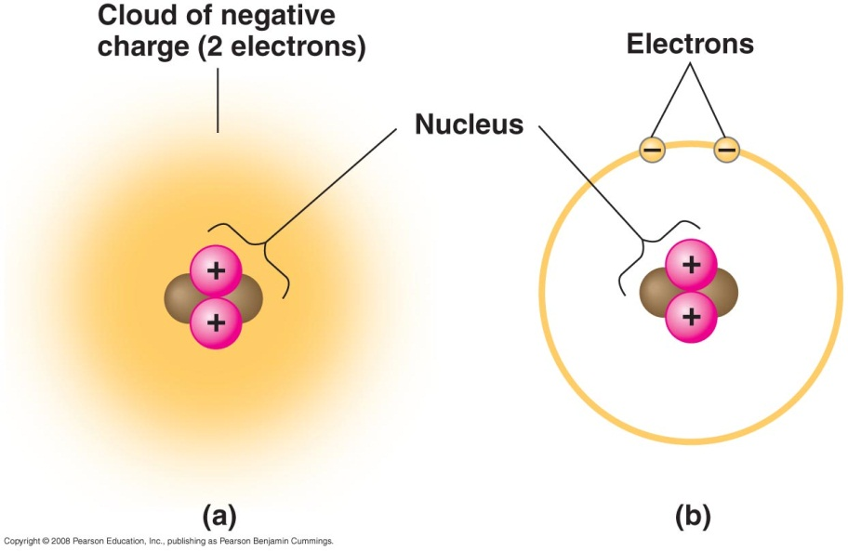
Chemicals of Life
Matter
Chemical Reactions
Electrons + protons + neutrons = atoms
Elements →compounds
Chemical signalling (interactions)
Transfer matter (interactions)
Transfer energy (energy)

Slide 2
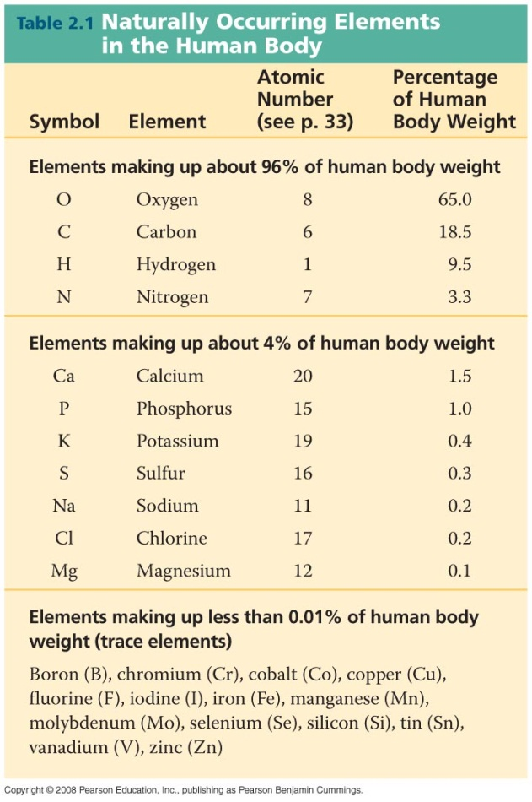
Essential elements
Necessary for life
Where
Big 6 important for structure (C, H, O, P, N, S)
DNA: C, H, O, P, N
Amino acids: C, H, O, N, S
Proteins: C, H, O, N, S
Trace elements important in cellular & molecular function

Slide 3
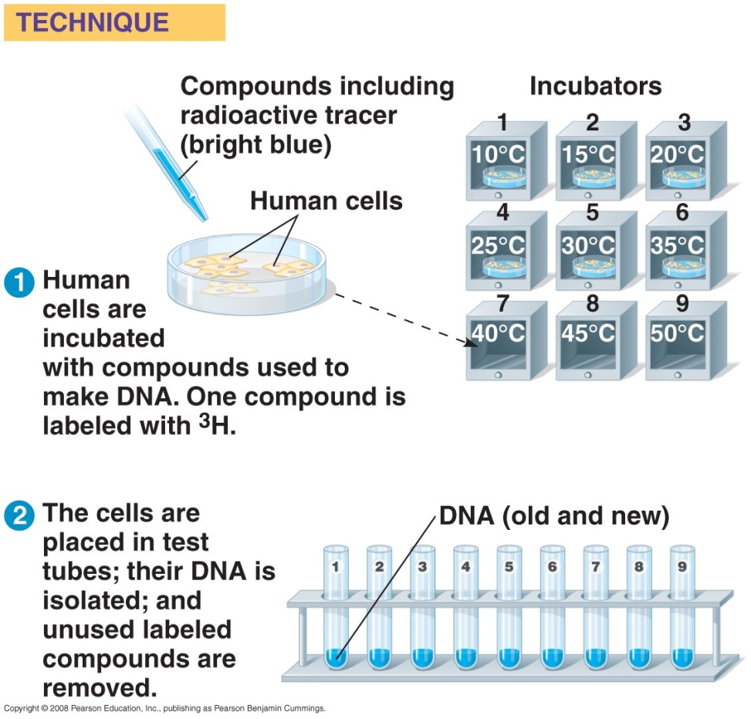
Technological advances
Manipulating compounds
Uses
Molecules can be “tagged” with radioactive isotopes
Molecules can be designed to interact with cells
Genetic engineering (reading, cutting, splicing… DNA)

Slide 4
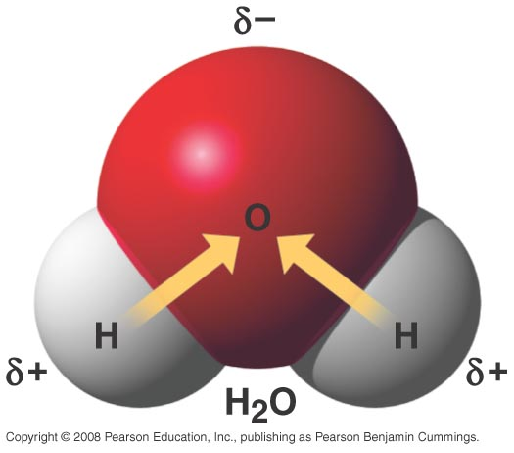
Shape matters
Electrons → bonding → shape → function
Shape determines interactions
Molecules interact by in living systems by shapes
Often called a lock-and-key model
These are surface to surface interactions

Slide 5
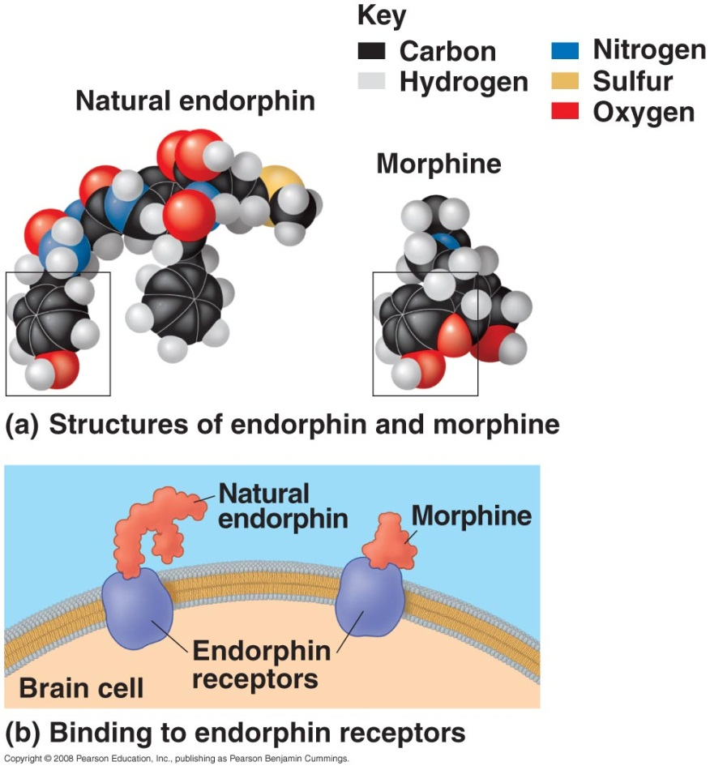
Shape matters
Receptor site mimic:
Molecular shape match:
Chemical with same shape at binding site to match receptor site on cell
Has similar effects in the body but can have other effects too (addiction, cellular function disrupted,…)
http://www.youtube.com/watch?v=Ms_ehUVvKKk

Slide 6
Chemical reactions
photosynthesis
Chemical equilibrium
6CO2 + 6H2O → C6H12O6 + 6O2
Most reactions go both ways and reach an equilibrium point
Chemical changes can push the reaction away from equilibrium
3 H2 + N2 ↔ 2 NH3

Slide 7
Patterns
Isn’t that weird?
Hurricane Isaac makes landfall in Louisiana 7 years to the day that Katrina hit.
http://www.thecajuns.com/lahurricanes.htm

