Slide 1
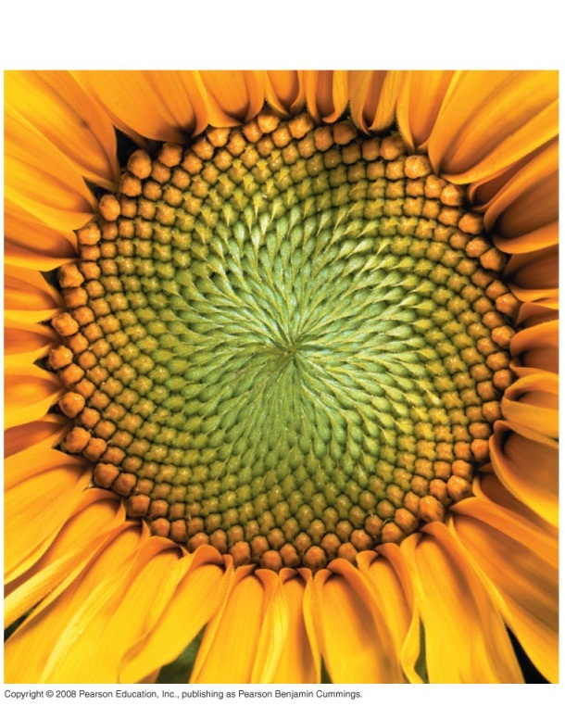
Life is organized
What are non-living examples of order in the universe?
Notes
Order; we see as patterns
entropy= randomness in the universe; tends to increase
Life creates order
Many levels

Slide 2
Levels- defined by humans based on the patterns we see

Slide 3
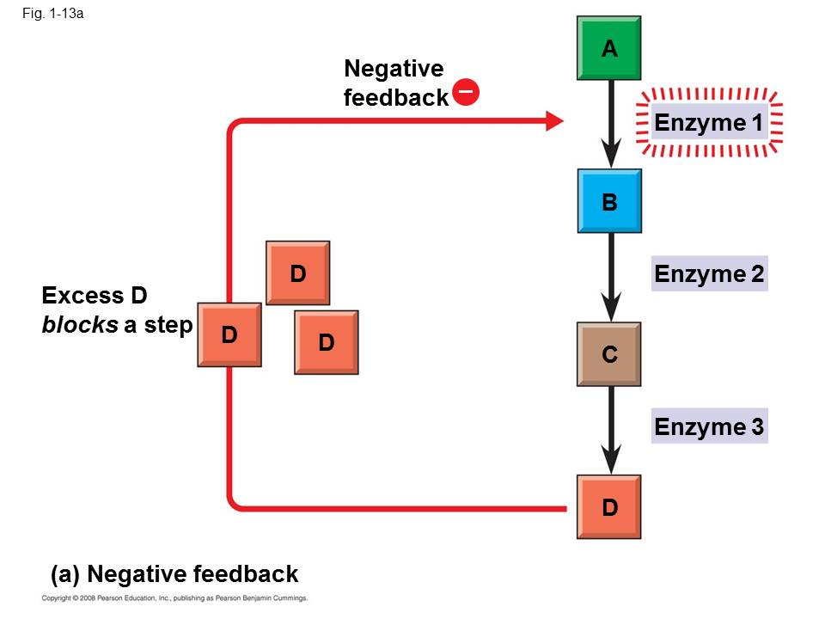
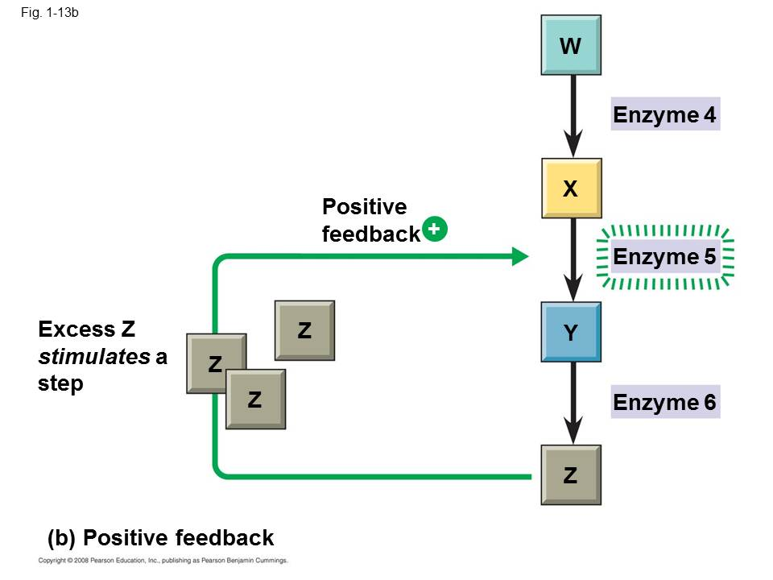
Theme- feedback loops (there can be loops within loops)
Negative: reverses direction
Positive: increases in same direction

Slide 4
Evolution is the core of biology
Confusion?
Darwin’s 3 observations support natural selection.
Individuals in a population vary. (remember populations evolve, individuals cannot).
More offspring can be produced than can survive.
Species are generally adapted to their environment.

Slide 5
Science has rules
Reasoning
Inductive = uses repeated observations to make generalizations (specific → general)
Deductive = uses generalizations to predict specific future events (general → specific)

Slide 6
Science has rules
Can you design an experiment?
Experimental design
A theory must be testable
A theory must be falsifiable (= there is a possible outcome that proves it false); a theory can be proven false, but never proven true only supported
The experiments or observations must be repeatable

