Slide 1
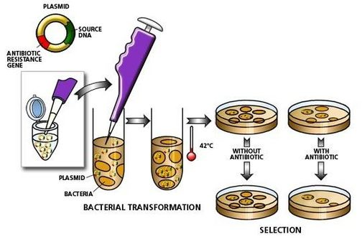
What did we try to show?

Slide 2
Bacterial Transformation LAB
Read the lab safety information and write the complete procedure (pp. S103-S105) in your notebook. THIS MUST BE DONE BEFORE YOU CAN PROCEED WITH THE LAB.
3. Write a simple hypothesis by comparing your sample with that of a partner’s, or design what to sample and test.
When I come around please flip notebook to the procedure you completed before starting the lab yesterday. 20 points.
Can recover lost points by writing a good practice hypothesis:
Null/alternative
OR
If/then statement

Slide 3
Bacterial Transformation LAB
Make a hypothesis.
Hypotheses (write all possible outcomes of experiment)
• H₀ : the null hypothesis; the hypothesis of no difference; e.g. the test group results were not different from the control group results (A=B)
• H₁ or H_{A} : the alternate hypothesis; the hypothesis of difference; the test group results were significantly different than the control group (A≠B)
• There can be more than one alternate hypothesis and they can be directional (<,>,≤,≥,…)
•Identify the:
Independent Variable (I.V.) = the one that you can control the change, this is the x-variable on a graph
Dependent Variable (D.V.) = the one that you measure the change, this is the y-variable on a graph
Form a hypothesis by following the general outline given at the beginning of the year:

Slide 4
Bacterial Transformation LAB
Think about what was in the plate.
+
LB
-
LB
What were you testing?
Why the different plates?
What will growth or no growth in the plates tell you?
What was expected to happen?
What does growth mean?
What does no growth mean?
-
LB- amp
+
LB-amp

Slide 5
Bacterial Transformation LAB
What is the null hypothesis?
If the plasmid was not taken up, we expect to find growth…
What does the bacteria without the plasmid tell us? (i.e. Why a control group?)
What is the alternative hypothesis?
If the plasmid was taken up we expect to find growth…
What does the LB-only plate tell us? (i.e. How is this a control?)
What are your variables?
So in your hypothesis include the following:

Slide 6
Bacterial Transformation LAB
■Analyzing Results
Think about these questions before collecting data and analyzing your results. Be sure to
record your answers in your laboratory notebook.
1. On which of the plates would you expect to find bacteria most like the original nontransformed
E. coli colonies you initially observed? Why?
2. If there are any genetically transformed bacterial cells, on which plate(s) would they
most likely be located? Again, why?
3. Which plates should be compared to determine if any genetic transformation has
occurred? Why?
4. What barriers might hinder the acquisition of plasmids?
5. How can the procedures described above (addition of CI2 and “heat shocking”) help
facilitate the introduction of plasmids into the E. coli cells?
Answer Analyzing Results questions
p. S105
But put before the Analyzing Results section.

Slide 7
Bacterial Transformation LAB
1. Do your results support your original predictions about the “+ plasmid” transformed
E. coli cells versus “- plasmid” nontransformed cells?
2. Which of the traits that you originally observed for E. coli did not seem to become
altered? Which traits seem now to be significantly different after performing the
transformation procedure?
3. What evidence suggests that the changes were due to the transformation procedures
you performed?
4. What advantage would there be for an organism to be able to turn on or off
particular genes in response to certain conditions?
5. Was your attempt at performing a genetic transformation successful? If so, how
successful?
Answer the next set of questions (p.S106)in essay form in your conclusion.

Slide 8
Bacterial Transformation LAB
Bacteria | Plasmid present | agar | growth | Number of individual colonies
E. coli | - | LB
E. coli | - | LB-amp
E. coli | + | LB
E. coli | + | LB-amp
Complete a data table in the results section of the write-up by looking at your plates

Slide 9
Bacterial Transformation LAB
Transformation efficiency =
$$\frac{Total number of colonies growing on plate}{Amount of DNA spread on plate (in μg) }$$
DNA in μg =
(concentration of DNA of μg/μL) x (volume of DNA in μL)
What was the volume of the DNA solution you put on the plate?
Calculations
We will use class data:
7 colonies total
Multiply your group’s DNA mass (𝜇𝑔) by 5 because there were 5 groups

Slide 10
Bacterial Transformation LAB
Calculate the total number of transformed cells.
n=7
Calculate the amount (mass) of plasmid DNA (pAMP) in μg per 1 μL of solution.
pAMP= (0.005μg/μL) x 10μL
pAMP = 0.05 μg x5
= 0.25 μg
Remember 5 groups:

Slide 11
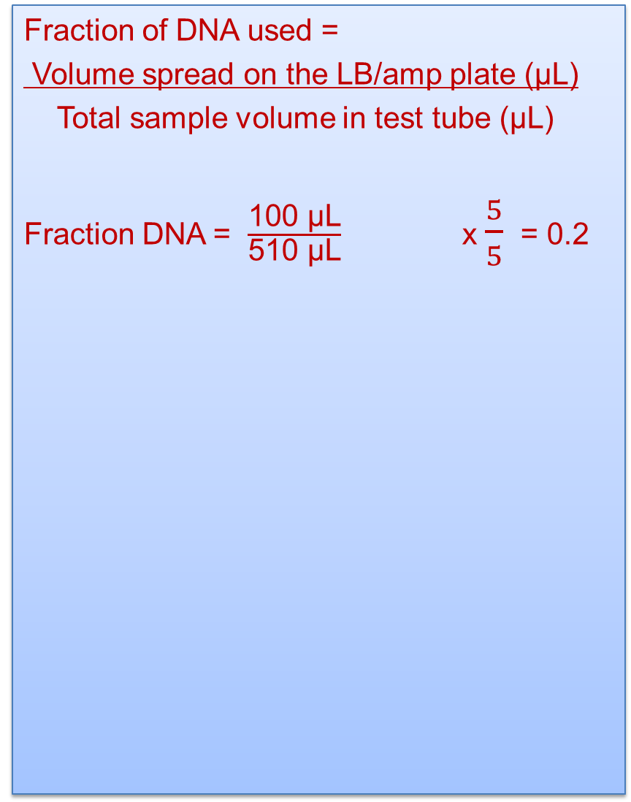
Bacterial Transformation LAB
Fraction of DNA used =
Volume spread on the LB/amp plate (μL)
Total sample volume in test tube (μL)
Fraction DNA = $\frac{\text{100 }\text{μL}}{\text{510 }\text{μL}}$ x $\frac{5}{5}$ = 0.2
Remember 5 groups:

